Slide 1
Modeling
Main issues:
• What do we want to build
• How do we write this down
©2008 John Wiley & Sons Ltd.
www.wileyeurope.com/college/van vliet
Notes:
© SE;Modeling, Hans van Vliet

Slide 2

System Modeling Techniques
Classic modeling techniques:
  Entity-relationship modeling
  Finite state machines
  Data flow diagrams
  CRC cards
Object-oriented modeling: variety of UML diagrams
©2008 John Wiley & Sons Ltd.
www.wileyeurope.com/college/van vliet
Notes:
© SE;Modeling, Hans van Vliet
The same, or sort of the same, techniques are used during requirements engineering and design.
OO models are treated in chapter 12 (OOAD).
Petri nets in the design chapter (11).
Here: entity relationship (as form of data-oriented technique), and state transition diagram

Slide 3
Entity-Relationship Modeling
entity: distinguishable object of some type
entity type: type of a set of entities
attribute value: piece of information (partially) describing an entity
attribute: type of a set of attribute values
relationship: association between two or more entities
©2008 John Wiley & Sons Ltd.
www.wileyeurope.com/college/van vliet
Notes:
© SE;Modeling, Hans van Vliet
Entities are like “things”

Slide 4
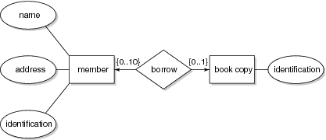
Example ER-diagram
©2008 John Wiley & Sons Ltd.
www.wileyeurope.com/college/van vliet
Notes:
© SE;Modeling, Hans van Vliet

Slide 5
Finite state machines
Models a system in terms of (a finite number of) states, and transitions between those states
Often depicted as state transition diagrams:
  Each state is a bubble
  Each transition is a labeled arc from one state to another
Large system ⇒ large diagram hierarchical diagrams: statecharts⇒
©2008 John Wiley & Sons Ltd.
www.wileyeurope.com/college/van vliet

Slide 6
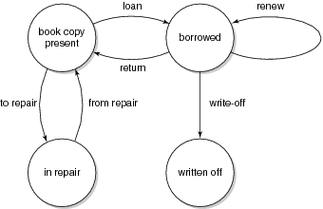
Example state transition diagram
©2008 John Wiley & Sons Ltd.
www.wileyeurope.com/college/van vliet

Slide 7
Data flow diagrams
external entities
processes
data flows
data stores
©2008 John Wiley & Sons Ltd.
www.wileyeurope.com/college/van vliet

Slide 8
Example data flow diagram
client
management
request
report
direction
prelim.
doc
log data
prelim.
doc
borrow
request
return
request
log data
acknowledgement
borrow
title
prelim.
doc
log file
title
title
catalog adm.
©2008 John Wiley & Sons Ltd.
www.wileyeurope.com/college/van vliet

Slide 9
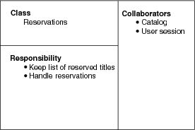
CRC: Class, Responsibility, Collaborators
©2008 John Wiley & Sons Ltd.
www.wileyeurope.com/college/van vliet

Slide 10
Intermezzo: what is an object?
Modeling viewpoint: model of part of the world
  Identity+state+behavior
Philosophical viewpoint: existential absractions
  Everything is an object
Software engineering viewpoint: data abstraction
Implementation viewpoint: structure in memory
Formal viewpoint: state machine
©2008 John Wiley & Sons Ltd.
www.wileyeurope.com/college/van vliet

Slide 11
Objects and attributes
Object is characterized by a set of attributes
  A table has a top, legs, …
In ERM, attributes denote intrinsic properties; they do not depend on each other, they are descriptive
In ERM, relationships denote mutual properties, such as the membership of a person of some organization
In UML, these relationships are called associations
Formally, UML does not distinguish attributes and relationships; both are properties of a class
©2008 John Wiley & Sons Ltd.
www.wileyeurope.com/college/van vliet

Slide 12
Objects, state, and behavior
State = set of attributes of an object
Class = set of objects with the same attributes
Individual object: instance
Behavior is described by services, a set of responsibilities
Service is invoked by sending a message
©2008 John Wiley & Sons Ltd.
www.wileyeurope.com/college/van vliet

Slide 13
Relations between objects
Specialization-generalization, is-a
  A dog is an animal
  Expressed in hierarchy
Whole-part, has
  A dog has legs
  Aggregation of parts into a whole
  Distinction between ‘real-world’ part-of and ‘representational’ part of (e.g. ‘Publisher’ as part of ‘Publication’)
Member-of, has
  A soccer team has players
  Relation between a set and its members (usually not transitive)
©2008 John Wiley & Sons Ltd.
www.wileyeurope.com/college/van vliet

Slide 14
Specialization-generalization relations
Usually expressed in hierarchical structure
  If a tree: single inheritance
  F a DAG: multiple inheritance
Common attributes are defined at a higher level in the object hierarchy, and inherited by child nodes
Alternative view: object hierarchy is a type hierarchy, with types and subtypes
©2008 John Wiley & Sons Ltd.
www.wileyeurope.com/college/van vliet

Slide 15
Unified Modeling Language (UML)
Controlled by OMG consortium: Object Management Group
Latest version: UML 2
UML 2 has 13 diagram types
  Static diagrams depict static structure
  Dynamic diagrams show what happens during execution
Most often used diagrams:
  class diagram: 75%
  Use case diagram and communication diagram: 50%
  Often loose semantics
©2008 John Wiley & Sons Ltd.
www.wileyeurope.com/college/van vliet

Slide 16
UML diagram types
Static diagrams:
Class
Component
Deployment
Interaction overview
Object
Package
Dynamic diagrams:
Activity
Communication
Composite structure
Sequence
State machine
Timing
Use case
©2008 John Wiley & Sons Ltd.
www.wileyeurope.com/college/van vliet

Slide 17
UML class diagram
depicts the static structure of a system
most common example: subclass/superclass hierarchy
also mutual properties between two or more entities (ER relationships, often called associations in OO)
©2008 John Wiley & Sons Ltd.
www.wileyeurope.com/college/van vliet
Notes:
© SE;Modeling, Hans van Vliet
So, a UML class diagram has much in common with the “old” ER diagrams

Slide 18
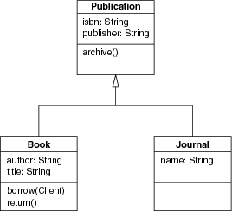
Example class diagram (1): generalization
©2008 John Wiley & Sons Ltd.
www.wileyeurope.com/college/van vliet
Notes:
© SE;Modeling, Hans van Vliet
See also chapter 12, on object-oriented analysis and design

Slide 19
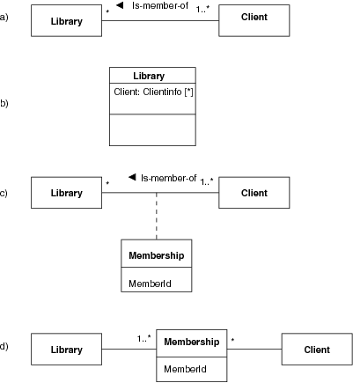
Example class diagram (2) association
©2008 John Wiley & Sons Ltd.
www.wileyeurope.com/college/van vliet
Notes:
© SE;Modeling, Hans van Vliet

Slide 20
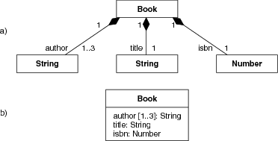
Example class diagram (3): composition
©2008 John Wiley & Sons Ltd.
www.wileyeurope.com/college/van vliet

Slide 21
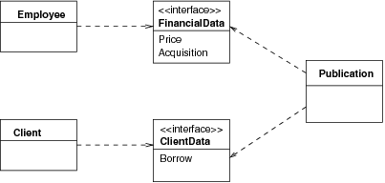
Interface: class with abstract features
©2008 John Wiley & Sons Ltd.
www.wileyeurope.com/college/van vliet
Notes:
© SE;Modeling, Hans van Vliet

Slide 22
State machine diagram
Resembles finite state machines, but:
Usually allows for local variables of states
Has external inputs and outputs
Allows for hierarchical states
©2008 John Wiley & Sons Ltd.
www.wileyeurope.com/college/van vliet

Slide 23
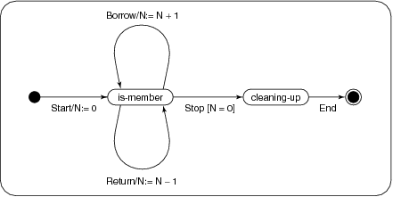
Example state machine diagram
©2008 John Wiley & Sons Ltd.
www.wileyeurope.com/college/van vliet

Slide 24
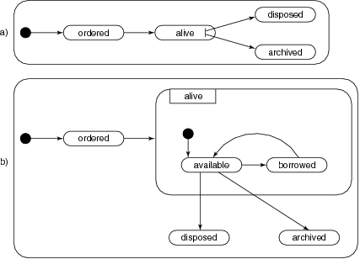
Example state machine diagram: global and expanded view
©2008 John Wiley & Sons Ltd.
www.wileyeurope.com/college/van vliet

Slide 25
Interaction diagram
Two types: sequence diagram and communication diagram
Sequence diagram: emphasizes the ordering of events, using a lifeline
Communication diagram emphasizes objects and their relationships
©2008 John Wiley & Sons Ltd.
www.wileyeurope.com/college/van vliet

Slide 26
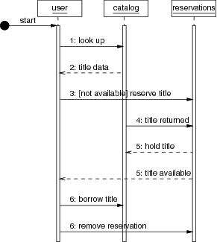
Example sequence diagram
©2008 John Wiley & Sons Ltd.
www.wileyeurope.com/college/van vliet

Slide 27
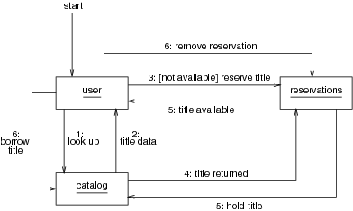
Example communication diagram
©2008 John Wiley & Sons Ltd.
www.wileyeurope.com/college/van vliet

Slide 28
Component diagram
Class diagram with stereotype <<component>>
Way to identify larger entities
One way to depict a module view (see Software Architecture chapter)
Components are connected by interfaces
©2008 John Wiley & Sons Ltd.
www.wileyeurope.com/college/van vliet

Slide 29
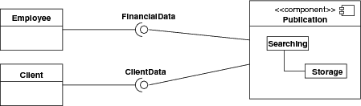
Example component diagram
©2008 John Wiley & Sons Ltd.
www.wileyeurope.com/college/van vliet

Slide 30
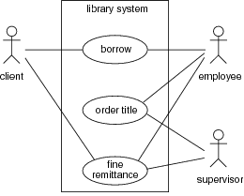
Use case diagram
©2008 John Wiley & Sons Ltd.
www.wileyeurope.com/college/van vliet

Slide 31

Summary
Classic notations:
  Entity-relationship diagrams
  Finite state machines
  Data flow diagrams
  CRC cards
Unified Modeling Language (UML)
  evolved from earlier OO notations
  13 diagram types
  widely used
©2008 John Wiley & Sons Ltd.
www.wileyeurope.com/college/van vliet

